Slide 1
ERP System for College Management Group 03
Presented By
Gopaladinne Deepak Kumar Reddy(Team Leader)
Grandhisila Venkata Naga Lakshmi Pravallika
Dudyala Dinesh Kumar
Enukonda Bava Fakruddin
Eeduri Kumar
Duggana Bhanu Prasanthi Kumari
Girish G N
Gaurav Prashant Kale
Gouri Nandu Doiphode
Gayathri B

Slide 2
Abstract :
The main objective of college management system is to automate all functionalities of a college or university. Using this system you can manage all college management work like admission, fees submission, time table management and result declaration.
Using this college management system you can view or update data and information about students and staff easily. This system helps in managing the activity like student admission, student registration, fees submission. Admin can also retrieve information of employee student.
The COLLEGE MANAGEMENT SYSTEM can be used to store student information like attendance, fees, and student result etc. admin can create report regarding any student any time using this system. Using this system you can register new student and their course details.
This system also help teacher to announce the result. College administration can also manage college work easily. They can also create time table of classes from this system.
The Library module is used for the data process of library and book accessing for students and staffs.

Slide 3
Objective :
Managing a school, university, college or any educational institution without a perfect software solution in the present times is painful, same in the case of any enterprises or business. Hence an appropriate solution is required which can ensure the smooth functioning of the organization as a whole, and with ERP college Management Module, this problem can simply be solved.
ERP College Management Module which is used by Schools as well as Colleges to manage their daily activities which include the management of Employees, Students, Books and Library Records, Parents details, Assignments, Admission Process, Results and Reports, Exams, Events, Attendance, Timetable, Fees and Other Reports. It provides one-point access to manage these wide range of activities both effectively and efficiently.
To increase data accuracy and make college management system more secure, effective, convenient and accessible.

Slide 4
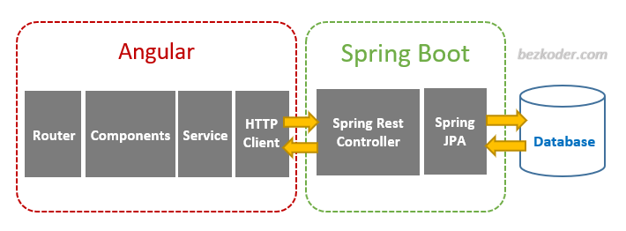
Project Architecture :

Slide 5



Tools & Technologies Used :
Front-End : Angular
Server-side : Spring Boot
Back-end : MYSQL, Hibernate
Server : Tomcat

Slide 6
HTML & CSS :
HTML (the Hypertext Markup Language) and CSS (Cascading Style Sheets) are two of the core technologies for building Web pages.
HTML provides the structure of the page, CSS the (visual and aural) layout, for a variety of devices.
Along with graphics and scripting, HTML and CSS are the basis of building Web pages and Web Applications.
HTML is the language for describing the structure of Web pages and CSS is the language for describing the presentation of Web pages, including colors, layout, and fonts.

Slide 7

Angular :
Angular is a platform and framework for building single-page client applications using HTML and TypeScript.
Angular is written in TypeScript. It implements core and optional functionality as a set of TypeScript libraries that you import into your applications.
The architecture of an Angular application relies on certain fundamental concepts. The basic building blocks of the Angular framework are Angular components that are organized into NgModules.

Slide 8
Spring Boot :
Spring Boot is an open source Java-based framework used to create a micro Service and is used to build stand-alone and production ready spring applications.
It provides a flexible way to configure Java Beans, XML configurations, and Database Transactions.
It provides an easier and faster way to set up, configure, and run both simple and web-based applications.

Slide 9
MySQL :
MySQL is currently the most popular database management system software used for managing the relational database.
It is open-source database software, which is supported by Oracle Company.
It is fast, scalable, and easy to use database management system in comparison with Microsoft SQL Server and Oracle Database.
MySQL follows the working of Client-Server Architecture. This model is designed for the end-users called clients to access the resources from a central computer known as a server using network services.

Slide 10
Modules Description :
The system comprises of 4 major modules with their sub-modules as follows:
Admin:
Login: Admin can login his personal account.
Add/View Student: Admin add student detail into a system.
Add/View Teacher: Admin add Teacher detail into a system
Add Time-Table: Admin set and add time table.
Add Event: Admin add event detail into a system.
View/Delete Book Request: Admin can view and delete book request from database.
View Books: Admin can see all the books detail from database.

Slide 11
2. Faculty:
Login: Teacher can login in his personal account.
Add Assignment: Teacher can add assignment detail for the students.
Add Attendance: Teacher can add attendance detail into a database.
Add Result: Student can add result detail.
View Event: Teacher can view event detail from database.
3. Librarian:
Login: Librarian can login in his personal account.
Add Books: Librarian can add books into database for student use.
Request a Book: View student request for a book.
Issue a Book: View detail of all issue books.
Return a Book: view detail of all return book.
View Event: Librarian can view all the events.

Slide 12
4. Student :
Login: Student can login his personal account.
View Profile: Student can see his profile.
View Books: Student can view book added by librarian.
View Time-Table: Student can view all timetable detail.
View Assignment: Student can view all assignment detail added by teacher.
View Result: Student can view result.
View Attendance: Student can view attendance.
View Event: Student can view all event detail.

Slide 13
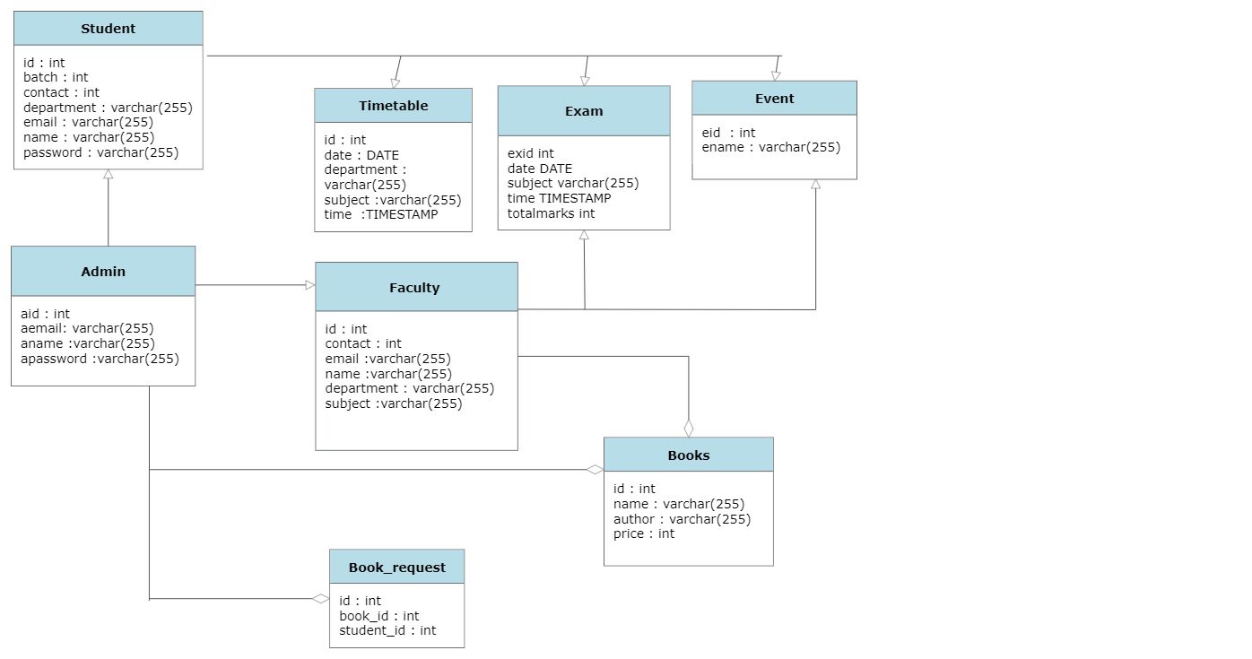
ER Diagram :

Slide 14
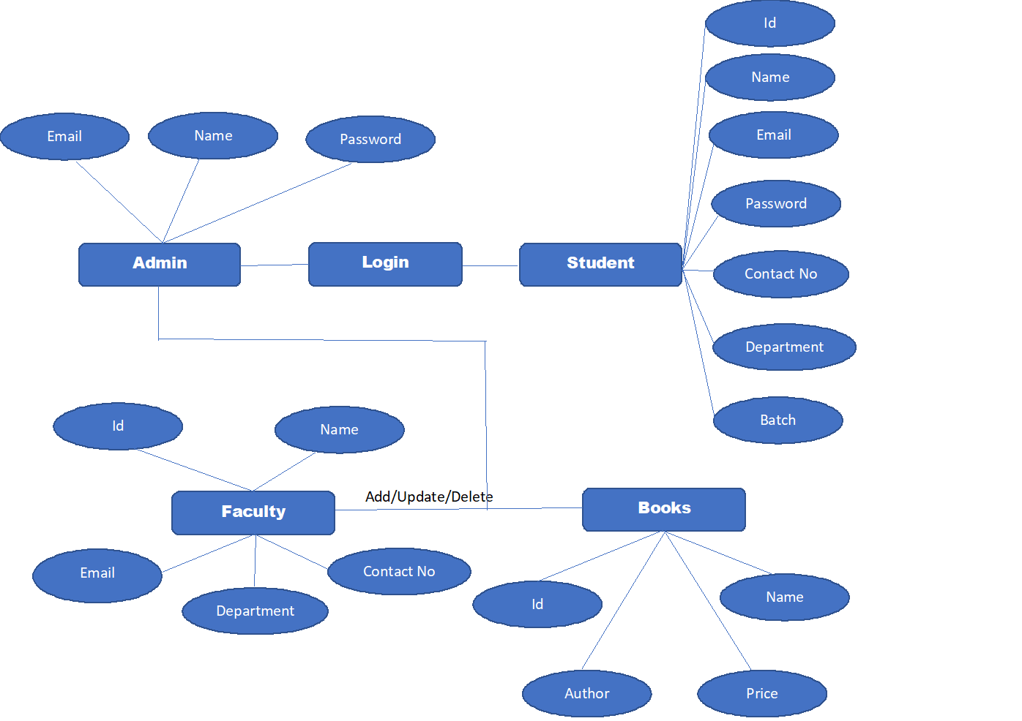
Class Diagram :

Slide 15
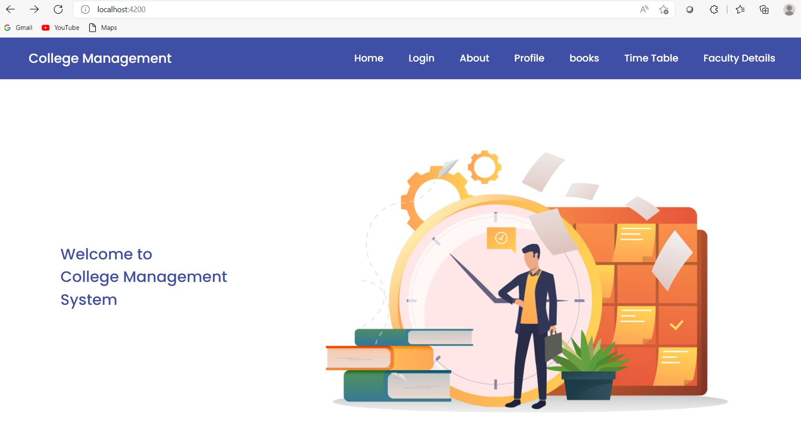
Outputs : Homepage :

Slide 16
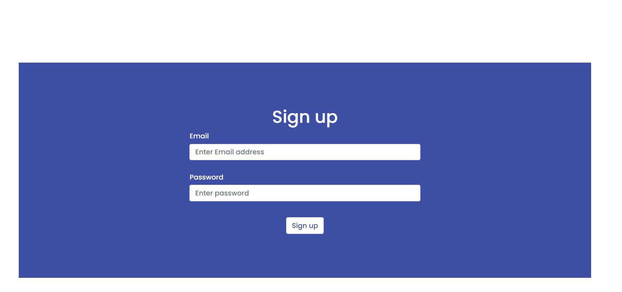
Sign up Page :

Slide 17
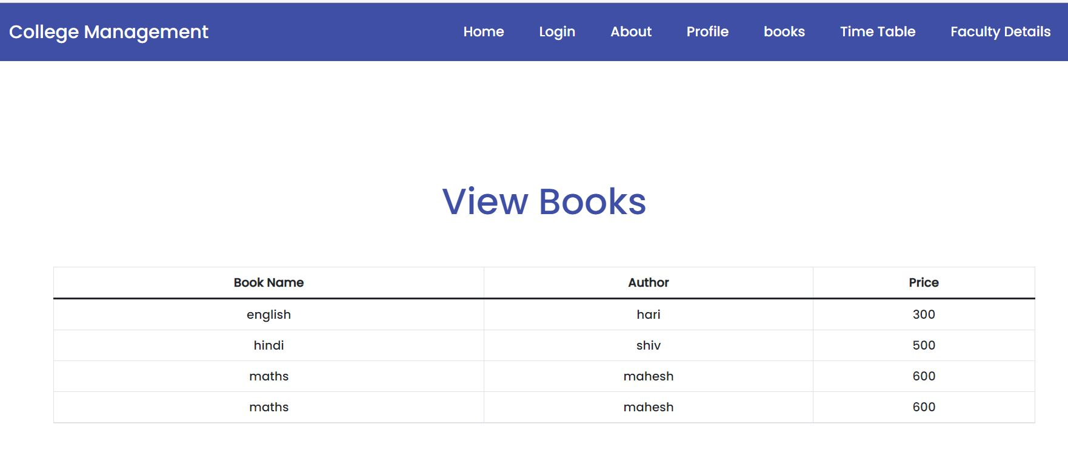
View Books :

Slide 18
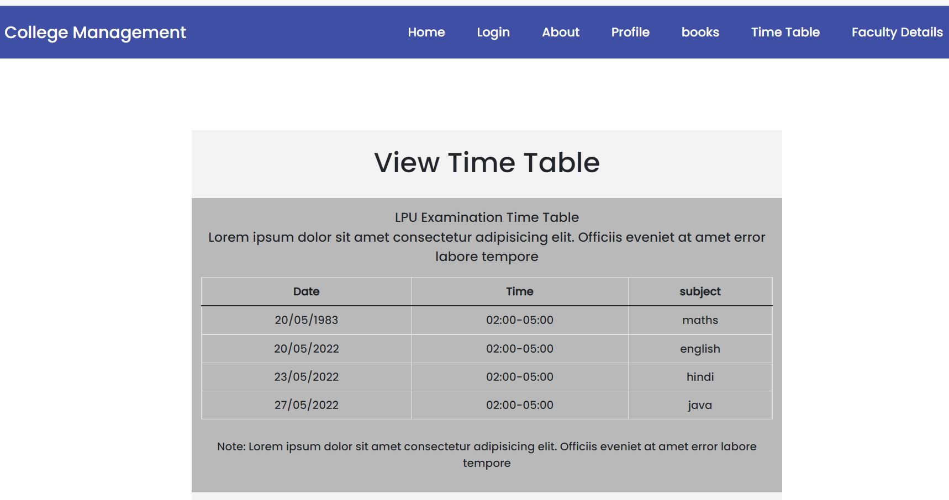
View Timetable :

Slide 19
Functional Testing using POSTMAN Tool :
Tests are automated by creating test suites that can run again and again.
Postman can be used to automate many types of tests including unit tests, functional tests, integration tests, end-to-end tests, regression tests, mock tests, etc. Automated testing prevents human error and streamlines testing.

Slide 20
Advantages :
This system is very easy to understand and user friendly.
Teacher, Student, Librarian are connected with each other on one system.
This system is saving the time for student and teacher too.
In this system user can connect any time whenever he/she wants.
This system is secure.

Slide 21
Applications :
College Management System can be useful for large, medium colleges.
Can give facility different type of enquires.
Management can maintain data regarding faculty, students easily and it can be updated easily.
User friendly.
Immediate data access.

Slide 22
Conclusion :
The project entitled as ERP system for College Management is the system that deals with the issues related to a particular institution.
This project is successfully implemented with all the features mentioned in system requirements specification.
The application provides appropriate information to users according to the chosen service.
The project is designed keeping in view the day to day problems faced by a college.
Deployment of our application will certainly help the college to reduce unnecessary wastage of time in personally going to each department for some information.

Slide 23


